Slide 1
Imputing methylation status
COS 424 Homework 2
Precept
Bianca Dumitrascu (last year’s AI)
Brian Jo
Elena Sizikova

Slide 2
37 000 000 000 000 ?

Slide 3
One trillion seconds of ordinary clock time =
( 1012 sec)/( 3.16 x 107 sec/yr) = 31,546 years!

Slide 4
> 100X the number of stars in our galaxy¹
1: http://asd.gsfc.nasa.gov/blueshift/index.php/2015/07/22/how-many-stars-in-the-milky-way/

Slide 5


Slide 6
~ 37 000 000 000 000
cells in the human body

Slide 7
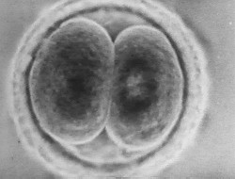
It starts like this,
from a fertilized zygote:

Slide 8
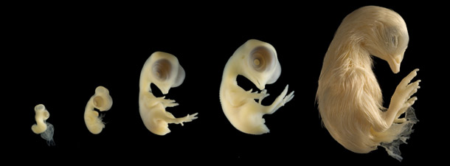
Cells are organized in tissues and organs giving rise to complex organisms

Slide 9
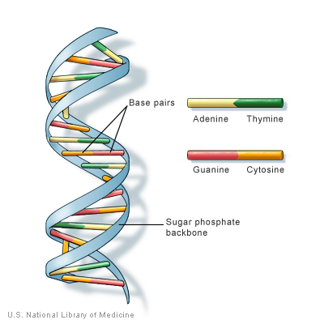
DNA: the central information unit

Slide 10
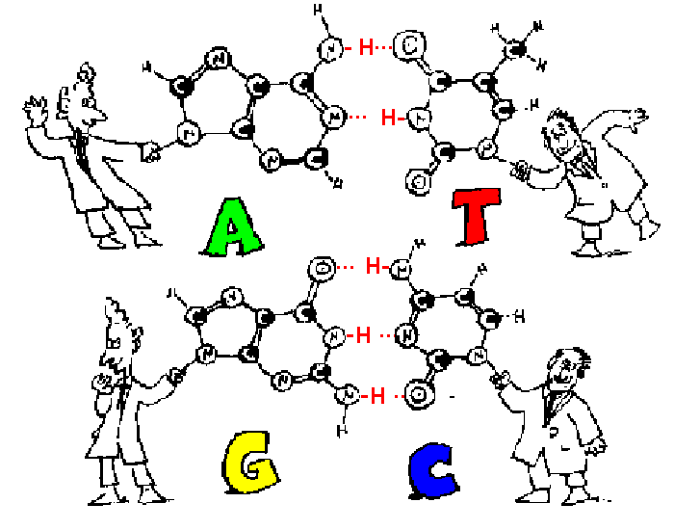

Slide 11
3 200 000 000 base pairs (human genome) Estimates 2~3 meters if stretched out²
2: http://hypertextbook.com/facts/1998/StevenChen.shtml

Slide 12
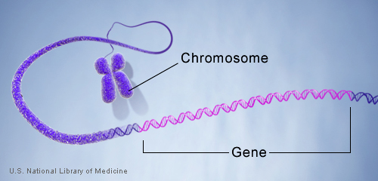

Slide 13
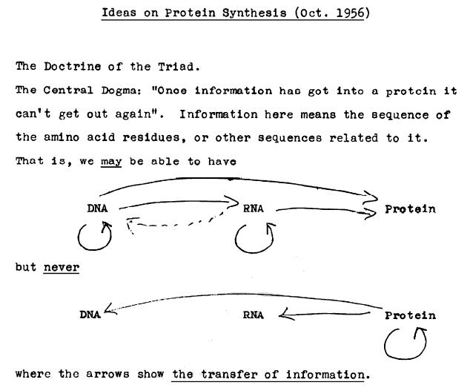
central dogma

Slide 14
3 base pairs = 1 amino acid

Slide 15
average gene ~ 300 aa

Slide 16
how many protein coding genes?

Slide 17
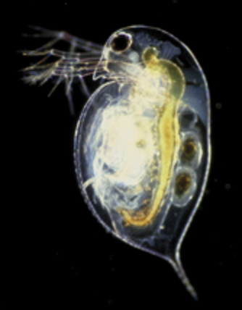
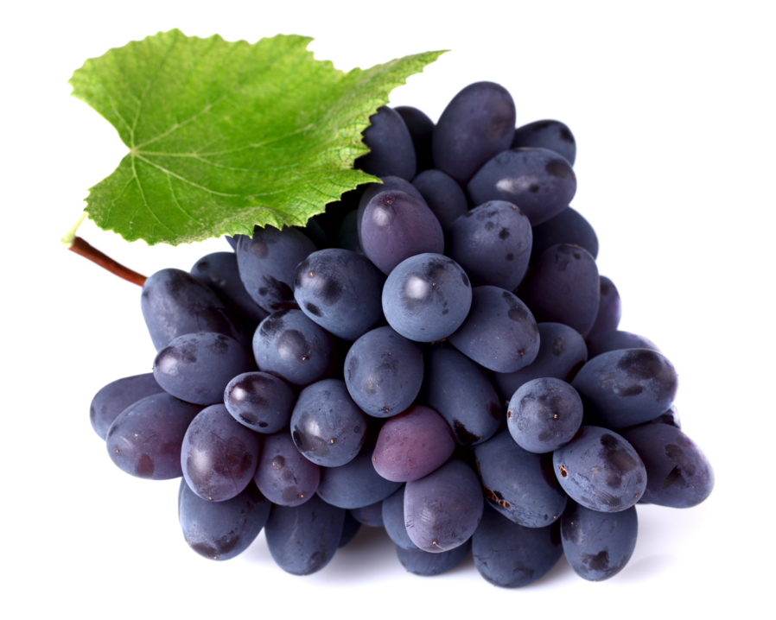
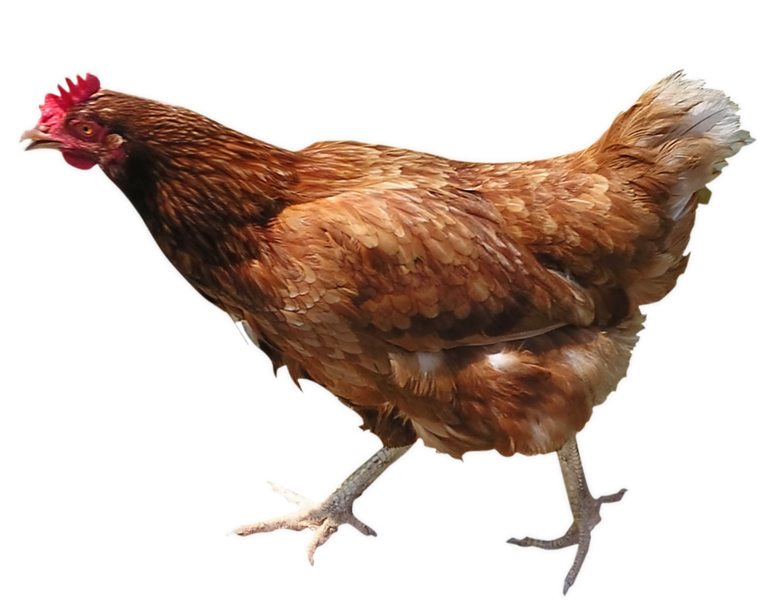
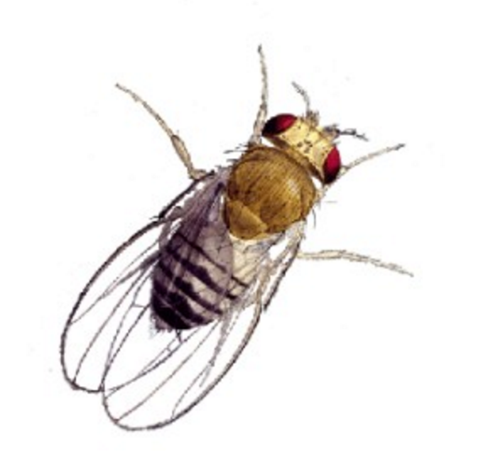
Order these organisms by number of genes: A) Water flea B) Grape C) Human D) Chicken E) Fruit Fly

Slide 18
Order these organisms by number of genes: A) Water flea ~31000 B) Grape ~30000 C) Human ~23000 D) Chicken ~16000 E) Fruit Fly ~14000

Slide 19
~ 20 000 to 24 000

Slide 20
Where does all the complexity come from then?

Slide 21
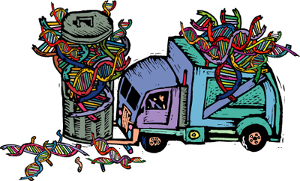
“junk” DNA

Slide 22
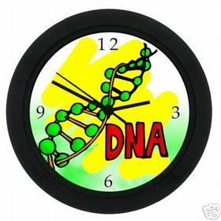
timing

Slide 23
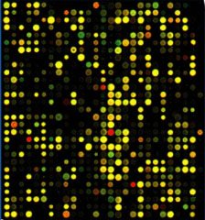
… together with complex mechanisms dictate when and which genes are active or not

Slide 24
Epigenetics (In particular, methylation)

Slide 25
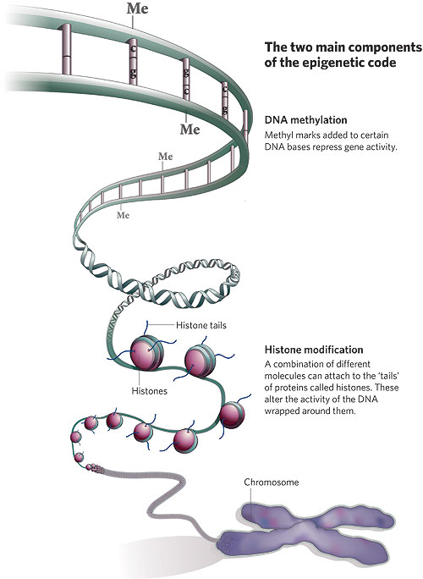

Slide 26
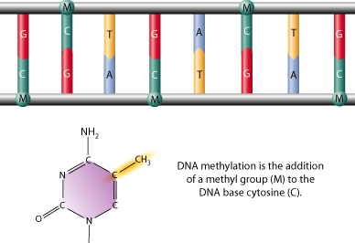
DNA methylation, historically the first epigenetic modification identified.

Slide 27
Formally:
Methylation is an enzyme-mediated chemical modification that adds methyl (CH3) groups to specific locations on proteins, DNA, and RNA.
It affects the Cytosine base (C) when it is followed by a Guanine (G) (CpG site)
Locations with high CpG (C followed by G) content are called CpG islands.

Slide 28
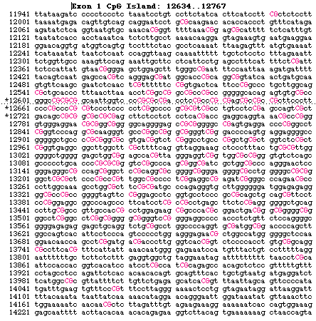

Slide 29
CpG Island
Informally:
sequences of 200 bp with GC content higher than 50%
“Vertebrate CpG islands (CGIs) are short interspersed DNA sequences that deviate significantly from the average genomic pattern by being GC-rich, CpG-rich, and predominantly nonmethylated.”
Deaton, Aimée M., and Adrian Bird. "CpG islands and the regulation of transcription." Genes & development 25.10 (2011): 1010-1022.

Slide 30
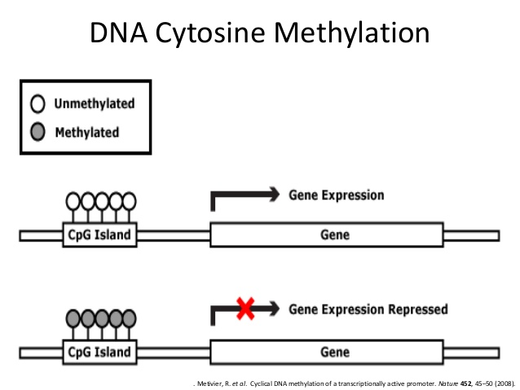
1985, Adrian Bird, CpG motifs are not randomly distributed across the genome, but they are concentrated up-stream of certain genes.

Slide 31
So far:
Methylation is correlated with gene expression (roughly)
Broad connections:
Cancer, development, cell identity/ memory

Slide 32
Epigenetic memory at embryonic enhancers identified in DNA methylation maps from adult mouse tissues
Gary C Hon, Nisha Rajagopal, Yin Shen, David F McCleary, Feng Yue, My D Dang & Bing Ren

Slide 33
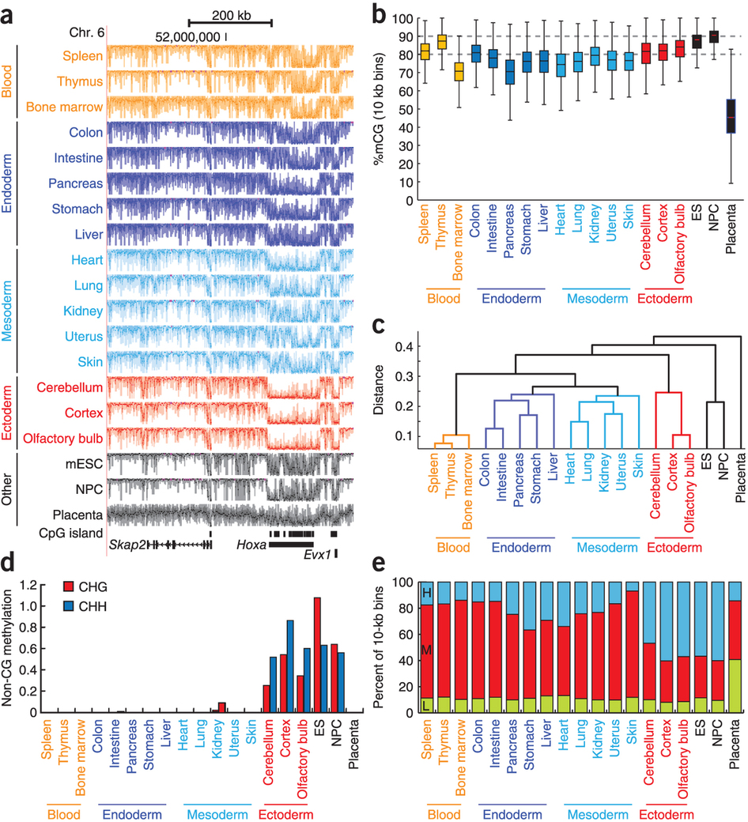
methylation heritable, and tissue depedent?

Slide 34
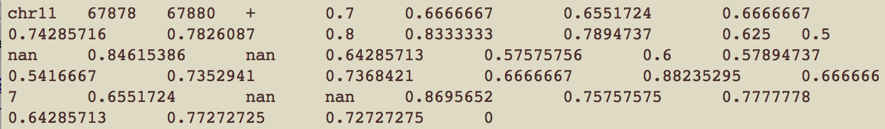
back to your project:
data
1 sample (float columns) = 1 tissue
1 row = a genomic position where CpGs are found

Slide 35
Some Question(s)
How do our “methylomes” vary and how can this variation be explained?
In detail, what are the tissues that are differentially methylated?
Do these patterns depend on which chromosome we consider?
What regions (positions) are most differentially methylated? Can those help us guess missing values?

Slide 36
technology:
whole genome bisulfite sequencing (WGBS)
- state-of-the-art technology for obtaining a comprehensive, nucleotide-resolution view of the epigenome

Slide 37
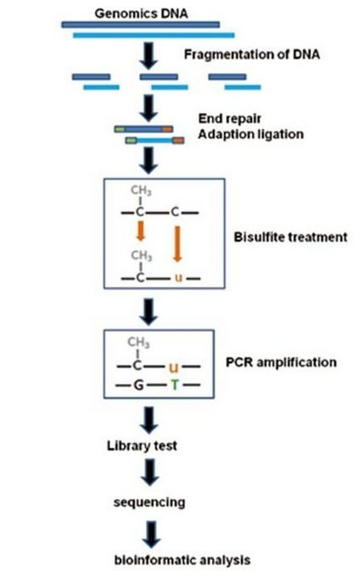

Slide 38
Issues
Noisy Data
Incomplete Data
(too expensive, too hard to collect)

Slide 39
Scenario: data can be collected at only few loci (compared to whole genome size)

Slide 40
Alternative: data can be collected at only few loci (compared to whole genome size)
Infinium HumanMethylation450 BeadChip Kit
Interrogates > 480,000 methylation sites per sample at single-nucleotide resolution. covers 99% of RefSeq genes, 96% of CpG islands
Averages 17 CpG sites per gene region distributed across the promoter, 5'UTR, first exon, gene body, and 3'UTR.
Covers
CpG sites outside of CpG islands
Non-CpG methylated sites identified in human stem cells
Differentially methylated sites identified in tumor versus normal (multiple forms of cancer) and across several tissue types
CpG islands outside of coding regions

Slide 41
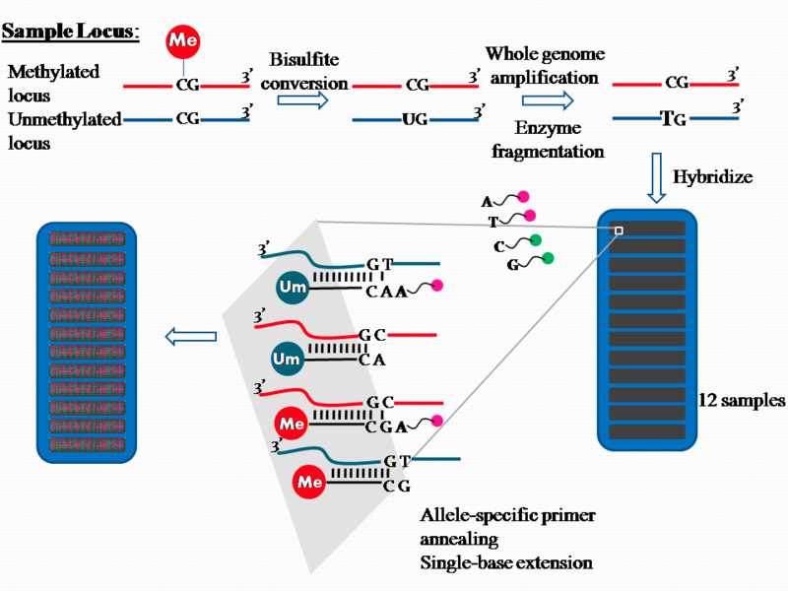
http://en.wikipedia.org/wiki/Illumina_Methylation_Assay#/media/File:Illuminamethylationworkflow.png

Slide 42
Imputation, or: dealing with missing data

Slide 43
~ 6M positions
Positions, chr 1: | 2000 | 23000 | 74333 | 100 000 | 3002330
Sample 1 | 0.9 | 0.4 | 0.8 | 0.8 | 0.2
Sample 2 | 0.9 | 0.6 | NaN | 0.6 | 0.5
Sample 3 | 0.9 | Nan | 0.9 | 0.8 | 0.8
… Sample 33 | 0.1 | 0.5 | 0.2 | 0.45 | 0.6
Sample X | ??? | 0.5 | ??? | 0.6 | ???
450K | 0 | 1 | 0 | 1 | 0
Oracle X sample_full.bed file | 0.9 | 0.5 | 0.4 | 0.6 | 0.7

Slide 44
Toy example for data in train.bed:
Which tissues are similar?
What can we guess about the unknown entries?
 | Liver | Testis | Lung | Astrocytes
Chr 1, 11231 | .3 | ??? | .5 | .3
Chr 2, 12132 | .4 | .4 | .2 | ???
Chr 1, 23224 | ??? | .4 | .2 | ???
Chr 1, 6237244 | .4 | ??? | .4 | .4
Chr 1, 352354354 | .2 | .3 | .1 | .1

Slide 45
Would taking the average work?
 | Liver | Testis | Lung | Astrocytes
Chr 1, 11231 | .3 | .37 | .5 | .3
Chr 2, 12132 | .4 | .4 | .2 | .33
Chr 1, 23224 | .3 | .4 | .2 | .3
Chr 1, 6237244 | .4 | .4 | .4 | .4
Chr 1, 352354354 | .2 | .3 | .1 | .1

Slide 46
we want: to impute the data (deal with the orange squares within the rectangle with blue edge), use
this to predict values for the red squares.
 | Liver | Testis | Lung | Astrocytes | Sample X | ORACLE
Chr 1, 11231 | .3 | NaN | .5 | .3 | 0.8 | 0.8
Chr2 12132 | .4 | .4 | .2 | NaN | 0.1 | 0.1
Chr 1 23224 | NaN | .4 | .2 | NaN | 0.4 | 0.4
Chr 1 6237244 | .4 | NaN | .4 | .4 | ??? | 0.3
Chr 1 352354354 | .2 | .3 | .1 | .1 | ??? | 0.2
= think of this as part of the Illumina 450K positions

Slide 47
we want: to impute the data (deal with the orange squares within the rectangle with blue edge), use
this to predict values for the red squares.
 | Liver | Testis | Lung | Astrocytes | Sample X | ORACLE
Chr 1, 11231 | .3 | .37 | .5 | .3 | 0.8 | 0.8
Chr2 12132 | .4 | .4 | .2 | .33 | 0.1 | 0.1
Chr 1 23224 | .3 | .4 | .2 | .3 | 0.4 | 0.4
Chr 1 6237244 | .4 | .4 | .4 | .4 | ??? | 0.3
Chr 1 352354354 | .2 | .3 | .1 | .1 | ??? | 0.2
= think of this as part of the Illumina 450K positions

Slide 48
In test.bed you will find the “gold standard”, reference numbers for you to use to check your prediction
 | Liver | Testis | Lung | Astrocytes | Sample X | ORACLE (test.bed)
Chr 1, 11231 | .3 | .37 | .5 | .3 | 0.8 | 0.8
Chr2 12132 | .4 | .4 | .2 | .33 | 0.1 | 0.1
Chr 1 23224 | .3 | .4 | .2 | .3 | 0.4 | 0.4
Chr 1 6237244 | .4 | .4 | .4 | .4 | ??? | 0.3
Chr 1 352354354 | .2 | .3 | .1 | .1 | ??? | 0.2
= think of this as part of the Illumina 450K positions

Slide 49
???
???

Slide 50
450K = data is collected at 450 000 positions (as opposed to collecting info from 3 billion pairs)

Slide 51
This is 0.0225% of the genome

Slide 52
1% of the genome contains CpG sites, therefore we cover ~2% of CpG sites

Slide 53
Is this enough to predict values at other positions?

Slide 54
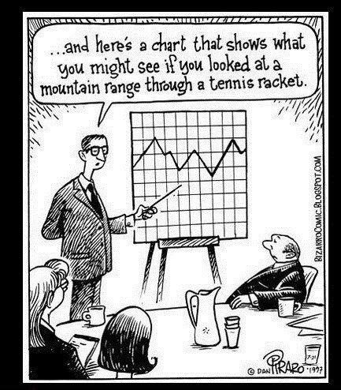

Slide 55
We will soon find out!

